Slide 1
Web Design Fundamentals /
Basic Web Design
JavaScript

Slide 2
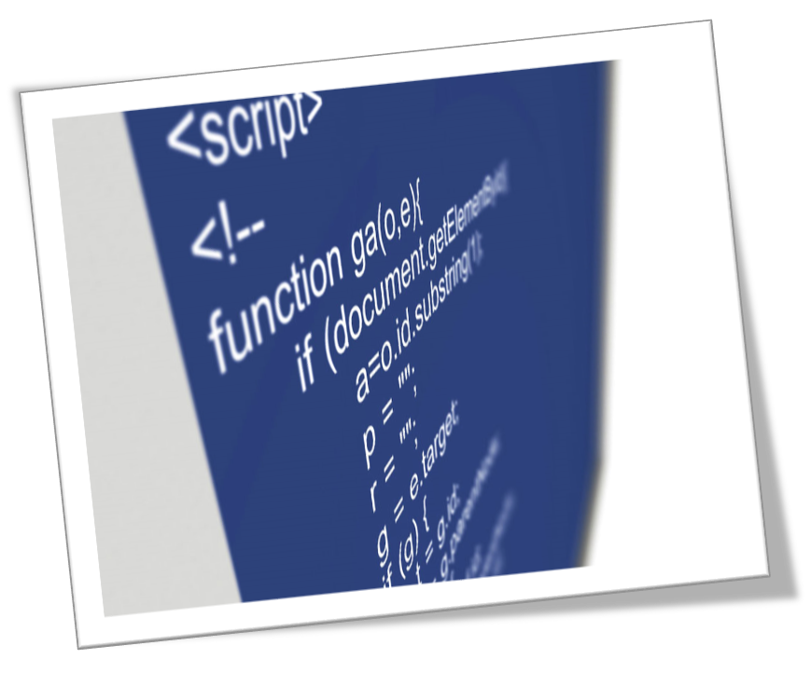
JavaScript Intro
Advanced Web Design

Slide 3
What you should know
HTML
CSS

Slide 4
What you should know
You don’t need to be a programmer
Though it’s a great help if you are.

Slide 5
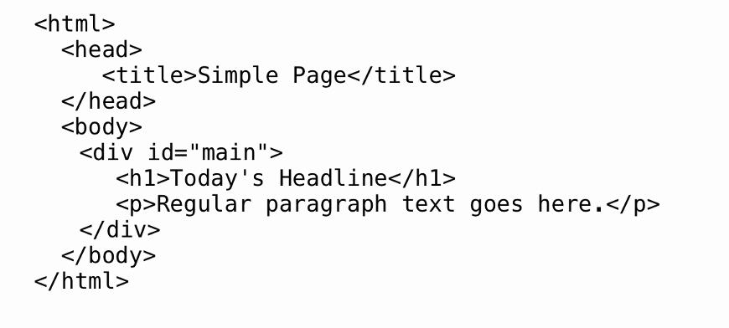
HTML

Slide 6
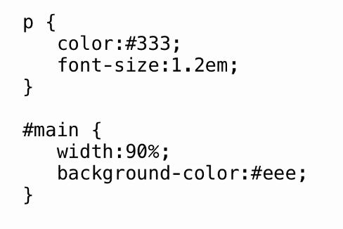
Connect
Bonjour
French

Slide 7
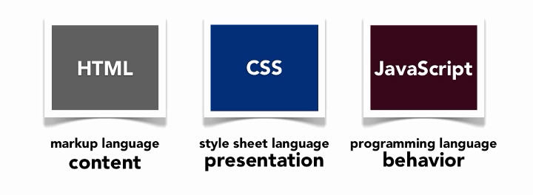
JavaScript: Introduction

Slide 8
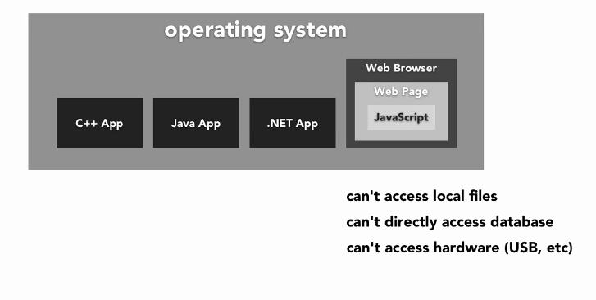
What is scripting language?

Slide 9
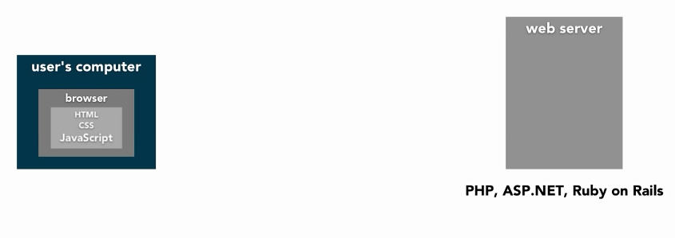
JS: Client-side language

Slide 10
What is Javascript (JS)?
One of the major web technology
JavaScript was designed to add dynamic interactivity to HTML pages
JavaScript is a scripting language
A scripting language is a lightweight programming language
Developed by Brendan Eich, co founder of Mozilla project

Slide 11
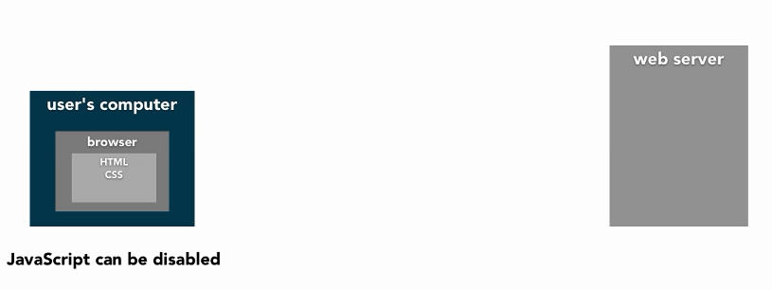
Issues with a client-side language
annyeong hashimnikka
Korean

Slide 12
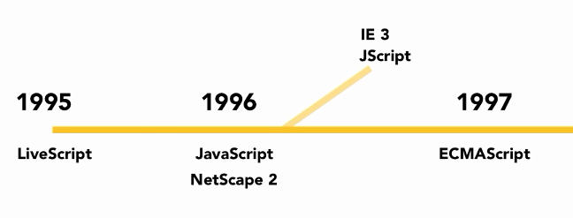
A bit History
Maayong Buntag
Cebuano

Slide 13
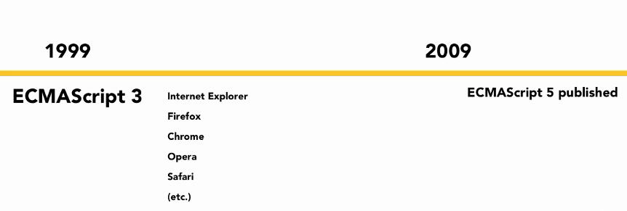
A bit History
Maayong Buntag
Cebuano

Slide 14
What do you need to write JS?
You need text editor

Slide 15
Are Java and Javascript the same?
NO!
Java and JavaScript are two completely different languages in both concept and design!
Java (developed by Sun Microsystems) is a powerful and much more complex programming language - in the same category as C and C++.

Slide 16
What can a Javascript do?
JavaScript gives HTML designers a programming tool - HTML authors are normally not programmers, but JavaScript is a scripting language with a very simple syntax! Almost anyone can put small "snippets" of code into their HTML pages.

Slide 17
What can a Javascript do?
JavaScript can react to events - A JavaScript can be set to execute when something happens, like when a page has finished loading or when a user clicks on an HTML element
JavaScript can read and write HTML elements - A JavaScript can read and change the content of an HTML element.

Slide 18
What can a Javascript do?
JavaScript can be used to validate data
JavaScript can be used to detect the visitor's browser

Slide 19
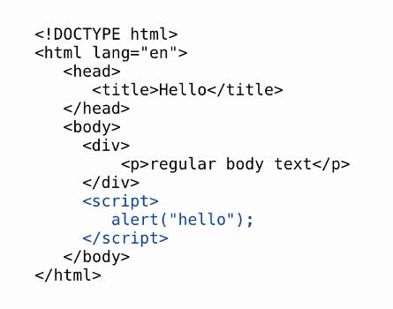
Javascript Structure 1

Slide 20
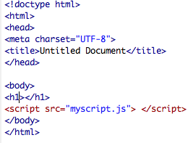

Javascript Structure 2
myscript.js
index.html

Slide 21
Javascript Where to!
JavaScripts can be put in the body and in the head sections of an HTML page.
(observe the difference)
JavaScripts in a page will be executed immediately while the page loads into the browser.

Slide 22
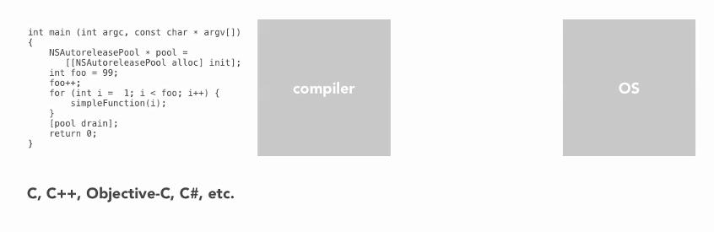
JS is interpreted not compiled

Slide 23
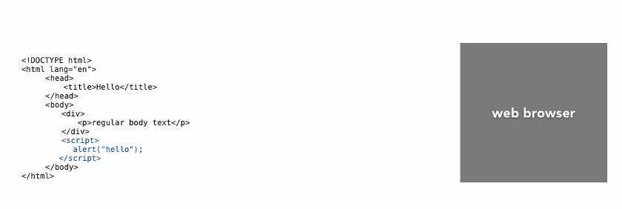
JS is interpreted not compiled

Slide 24
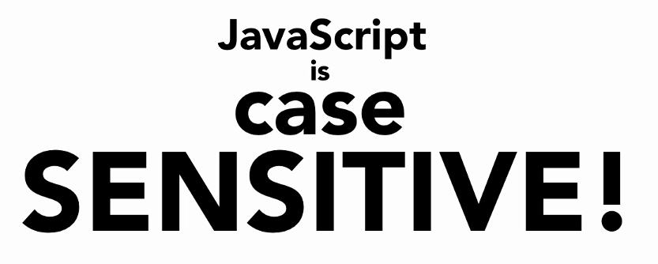

Slide 25
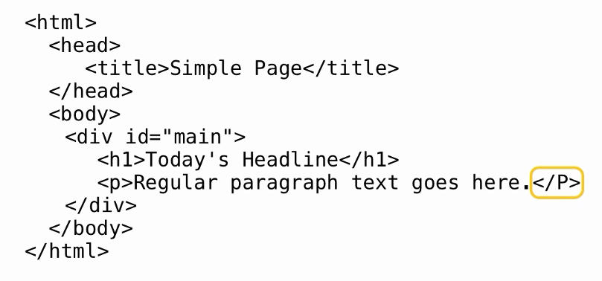
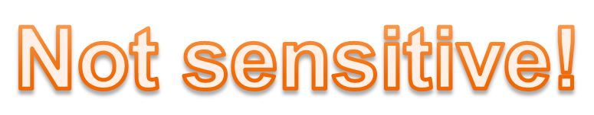
Javascript vs HTML

Slide 26
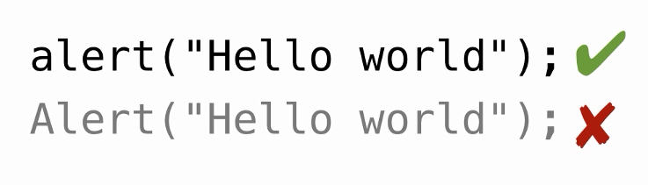

Javascript vs HTML

Slide 27
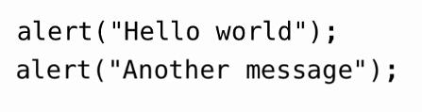

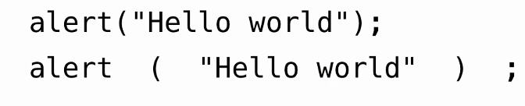
JS: Whitespace insensitive

Slide 28

Best practices

Slide 29
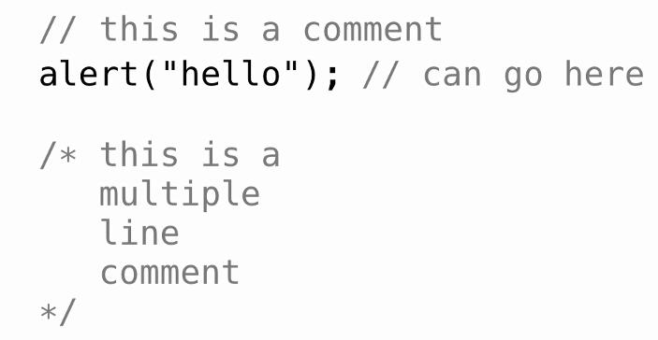
JavaScript Comments

Slide 30
JavaScript Comments

Slide 31
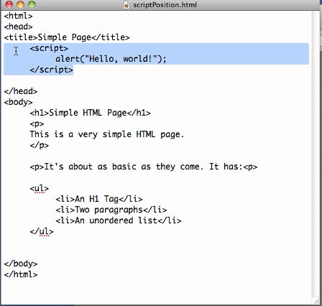
Sample
1.) Embedding script in HTML
2.) Script Positioning
Notes:
For example refer to:
0201 Understanding the structure of JavaScript code.mp4

Slide 32
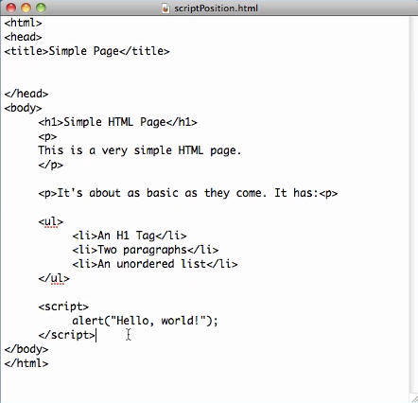
Sample
Notes:
For example refer to:
0201 Understanding the structure of JavaScript code.mp4

Slide 33
JS BASICS
variable
Variables are containers that you can store values in. You start by declaring a variable with the var keyword, followed by any name you want to call it
var myVariable;
After declaring a variable, you can give it a value:
myVariable = ”van”;
You can do both these operations on the same line if you wish:
var myVariable = ”van”;

Slide 34
The Lifetime of JavaScript Variables
If you declare a variable within a function, the variable can only be accessed within that function. When you exit the function, the variable is destroyed. These variables are called local variables. You can have local variables with the same name in different functions, because each is recognized only by the function in which it is declared.
If you declare a variable outside a function, all the functions on your page can access it. The lifetime of these variables starts when they are declared, and ends when the page is closed.

Slide 35
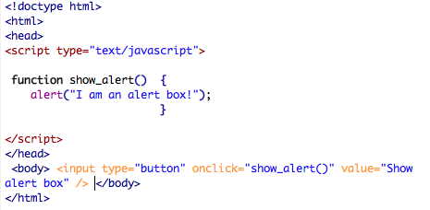
JavaScript Popup Boxes (Alert)

Slide 36
JavaScript Popup Boxes (Confirm)
A confirm box is often used if you want the user to verify or accept something.
When a confirm box pops up, the user will have to click either "OK" or "Cancel" to proceed.
If the user clicks "OK", the box returns true. If the user clicks "Cancel", the box returns false.

Slide 37
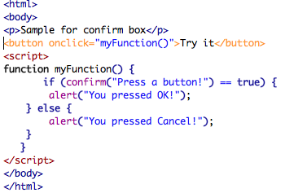
JavaScript Popup Boxes (Confirm)

Slide 38
@ FOR EMAIL
Note:
If you enter an email address without the @, you'll get an alert asking you to re-enter the data.
What is:x.indexOf(@)==-1? This is a method that JavaScript can search every character within a string and look for what we want. If it finds it will return the position of the char within the string.
If it doesn't, it will return -1. Therefore, x.indexOf("@")==-1 basically means: "if the string doesn't include @

Slide 39
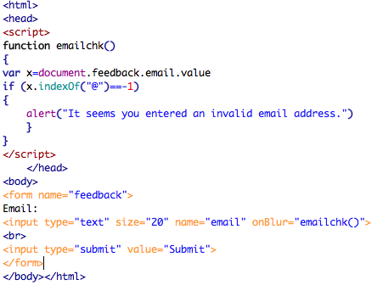
@ FOR EMAIL

Slide 40
JavaScript Prompt (User Input)
var myInput = prompt(“Enter a number: ");
alert(myInput==“2” ? “Your choice is number two" : "Input again");

Slide 41
JavaScript Functions
A function will be executed by an event or by a call to the function.
To keep the browser from executing a script when the page loads, you can put your script into a function.

Slide 42
JavaScript Functions (Sample)
<html>
<head>
<script type="text/javascript">
function displaymessage()
{
alert("Hello World!");
}
</script>
</head>
<body>
<form>
<input type="button" value="Click me!" onclick="displaymessage()" />
</form>
</body>
</html>

Slide 43
The return Statement
The return statement is used to specify the value that is returned from the function.
So, functions that are going to return a value must use the return statement.
The example below returns the product of two numbers (a and b):

Slide 44
The return Statement
<html>
<head>
<script type="text/javascript">
function product(a,b)
{
return a*b;
}
</script>
</head>
<body>
<script type="text/javascript">
document.write(product(4,3));
</script>
</body>
</html>

Slide 45
JavaScript For Loop
Loops execute a block of code a specified number of times, or while a specified condition is true.
In JavaScript, there are two different kind of loops:
  for - loops through a block of code a specified number of times
  while - loops through a block of code while a specified condition is true
Syntax
  for (var=startvalue;var<=endvalue;var=var+increment)
  {
  code to be executed
  }

Slide 46
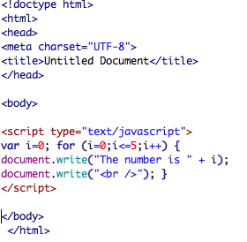
For Loop

Slide 47
JavaScript While Loop
The while loop loops through a block of code while a specified condition is true.
Syntax
  while (var<=endvalue)
  {
  code to be executed
  }

Slide 48
While Loop Example
<html>
<body>
<script type="text/javascript">
var i=0;
while (i<=5)
{
document.write("The number is " + i);
document.write("<br />");
i++;
}
</script>
</body>
</html>

Slide 49
The do...while Loop
The do...while loop is a variant of the while loop. This loop will execute the block of code ONCE, and then it will repeat the loop as long as the specified condition is true.
Syntax
  do
  {
  code to be executed
  }
  while (var<=endvalue);

Slide 50
The do...while Loop
<html>
<body>
<script type="text/javascript">
var i=0;
do
{
document.write("The number is " + i);
document.write("<br />");
i++;
}
while (i<=5);
</script>
</body>
</html>

Slide 51
The break Statement
  The break statement will break the loop and continue executing the code that follows after the loop (if any).
  <html>
  <body>
  <script type="text/javascript">
  var i=0;
  for (i=0;i<=10;i++)
  {
  if (i==3)
  {
  break;
  }
  document.write("The number is " + i);
  document.write("<br />");
  }
  </script>
  </body>
  </html>
JavaScript Break and Continue Statements

Slide 52
The continue statement will break the current loop and continue with the next value. The break statement will break the loop and continue executing the code that follows after the loop (if any).
  <html>
  <body>
  <script type="text/javascript">
  var i=0
  for (i=0;i<=10;i++)
  {
  if (i==3)
  {
  continue;
  }
  document.write("The number is " + i);
  document.write("<br />");
  }
  </script>
  </body>
  </html>
The continue Statement

